Slide 1
CSC 323 – Principles of Operating Systems
Instructor: Ms. Mamoona Tasadduq
Lecture# 3-6: CPU Scheduling

Slide 2

Recap: Processes, Threads
Process is the OS abstraction for execution
  Own view of machine
Process components
  Address space, program counter, registers, open files, etc.
  Kernel data structure: Process Control Block (PCB)
Process vs. thread
Process/thread states and APIs
  State graph and queues
  Process creation, deletion, waiting
Multiple processes/threads
  Overlapping I/O and CPU activities
  Context Switch

Slide 3
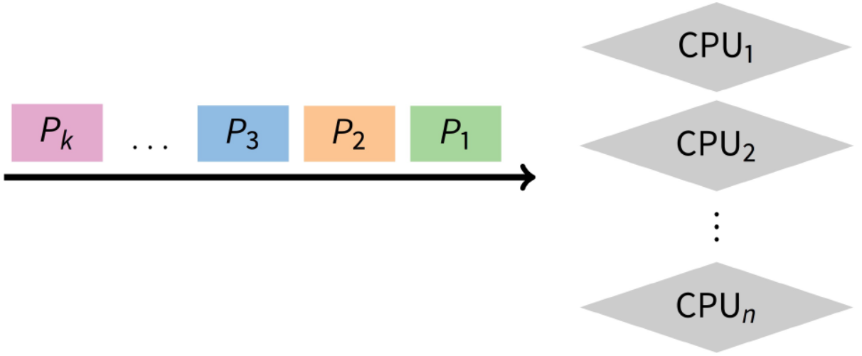
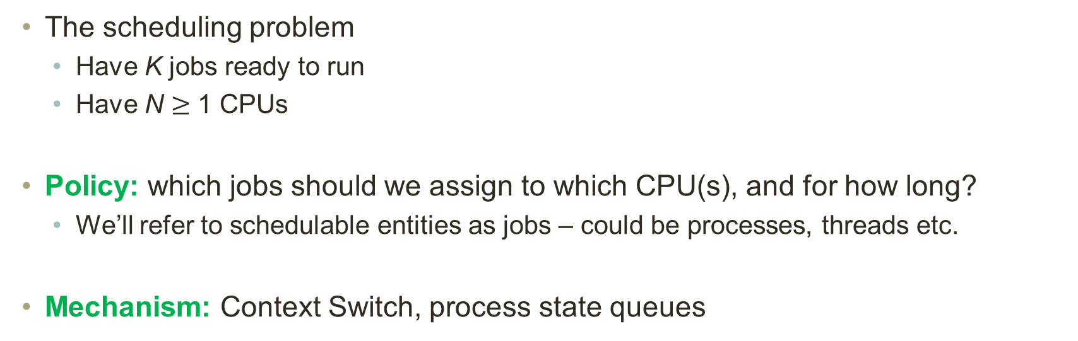
Scheduling Overview
The scheduling problem
  Have K jobs ready to run
  Have N $≥$ 1 CPUs
Policy: which jobs should we assign to which CPU(s), and for how long?
  We’ll refer to schedulable entities as jobs – could be processes, threads etc.
Mechanism: Context Switch, process state queues

Slide 4
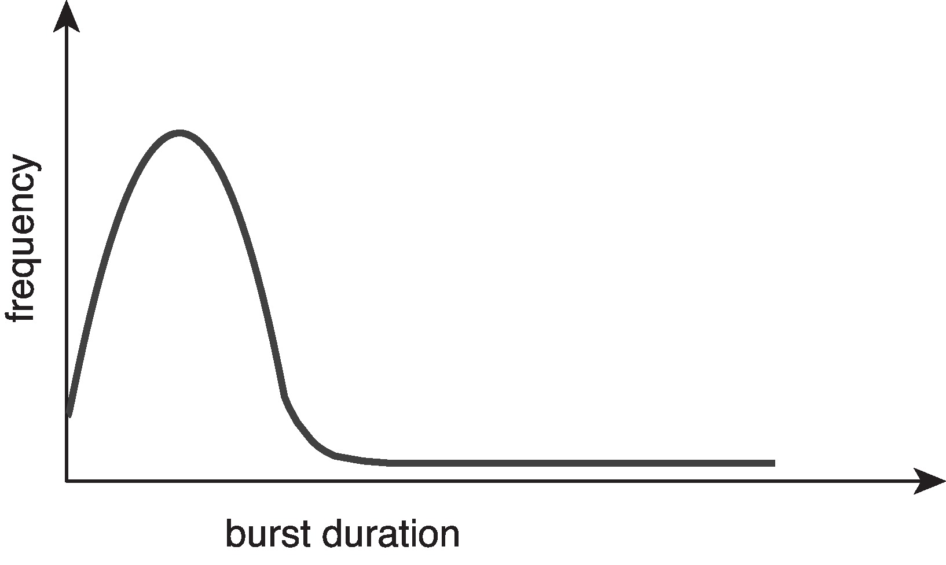
Challenges in Policy
Flexibility – variability in job types
  Long vs. short
  Interactive vs. non-interactive
  CPU-bound vs. I/O-bound
Issues?
  Short jobs should not suffer
  Users should not be annoyed
Fairness
  All users should get access to CPU
  Amount of CPU should be roughly even?
Issues?
  Short-term vs. long-term fairness
Histogram of CPU burst times

Slide 5
Scheduling Goal
Scheduling works at two levels in an operating system
  To determine the multiprogramming level – # of jobs loaded into memory
    Moving jobs to/from memory is often called swapping
  To decide what job to run next to guarantee “good service”
    Good service could be one of many different criteria
Known as long-term and short-term scheduling decisions
  Long-term scheduling happens relatively infrequently
    Significant overhead in swapping a process out to disk
  Short-term scheduling happens relatively frequently
    Want to minimize the overhead of scheduling
      Fast context switches, fast queue manipulation
(Virtual Memory Lecture)
(This Lecture)

Slide 6
Scheduling “Non-goal”: Starvation
Starvation is when a process is prevented from making progress because
some other process has the resource it requires
  Resource could be the CPU, or a lock (recall readers/writers)
Starvation usually a side effect of the scheduling algorithm
  A high priority process always prevents a low priority process from running
  One thread always beats another when acquiring a lock
Starvation can be a side effect of synchronization
  Constant supply of readers always blocks out writers

Slide 7
Types of Schedulers
Short-term scheduler (or CPU scheduler)
  Selects from among processes in ready queue, & allocates a CPU core to one of them
  Sometimes the only scheduler in a system
  Invoked frequently (milliseconds) → (must be fast)
  Dispatcher module gives control of CPU to process selected by short-term scheduler
  Dispatch latency: time taken for dispatcher to stop one process and start another
Long-term scheduler (or Job scheduler)
  Selects which processes should be brought into the ready queue
  Invoked infrequently (seconds, minutes) ➔ (may be slow)
  Controls the degree of multiprogramming
  Strives for good process mix (I/O and. CPU bound processes)

Slide 8
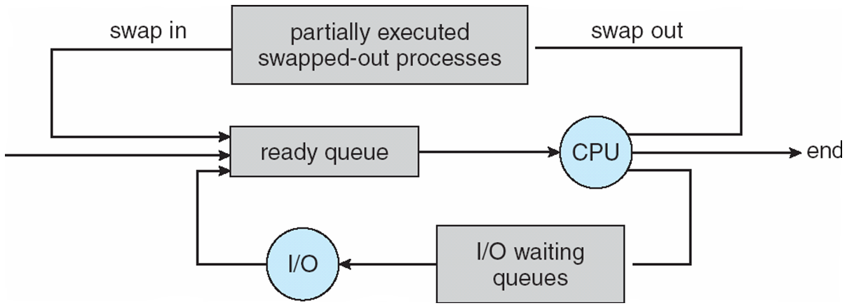
Types of Schedulers
Memory is a scarce resource and in a multiprogramming environment, we want to run many programs that need memory to execute.
  What happens when M(a) + M(b) + M(c) > physical memory?
Medium-term scheduler added to decrease the degree of multiprogramming
  Remove process from memory, store on disk, bring back in from disk to continue execution: known as job swapping

Slide 9
Scheduling Criteria
Why do we care?
  How do we measure the effectiveness of a scheduling algorithm?

Slide 10
Scheduling Criteria
Throughput – # of processes that complete per unit time (# jobs/time)
  Maximize
Turnaround time – time for each process to complete (T_{finish} – T_{start})
  Minimize
Response time – time from request to first response
  Minimize
Above criteria are affected by secondary criteria
CPU utilization – % CPU fraction of time CPU doing productive work
  Maximize
Waiting time – time each process waits in the ready queue
  Minimize

Slide 11
What Criteria Should We Use?
Batch systems
  Strive for job throughput, turnaround time (supercomputers)
Interactive systems
  Strive to minimize response time for interactive jobs (PC)
    Utilization and throughput are often traded off for better response time
Usually optimize average measure
  Sometimes also optimize for min/max or variance
    e.g., minimize the maximum response time
    e.g., users prefer predictable response time over faster but highly variable response time

Slide 12
When Do We Schedule CPU?
3
2
4
3
1
Scheduling decisions may take place when a process:
  Switches from running to waiting state
  Switches from running to ready state
  Switches from new/waiting to ready state
  Terminates
For (1) & (4), no choice in terms of scheduling. A new process must be selected.
For (2) & (3), however, there is a choice.

Slide 13
Non-preemptive Scheduling
Without any hardware support, what can the OS do to a running process?
  Non-preemptive scheduling: Once the CPU has been allocated to a process, the process keeps the CPU until it releases it either by terminating or by switching to the waiting state
  Invoked by explicit block/yield calls or terminations
  Only method when there is no timer!
System calls that triggers Scheduler
  Block – wait on some event/resource
    Network packet arrival (e.g. recv( ))
    Keyboard, mouse input (e.g. getchar( ))
    Disk activity completion (e.g. read( ))
  Yield – give up running for now
Used in Windows 3.1, Mac OS

Slide 14
Preemptive Scheduling
Without hardware support, can we do anything other than non-preemptive scheduling?
Timesharing systems support interactive use
  Each user feel he/she has the entire machine
  Optimize response time
  Based on time-slicing
Using timer interrupt to do CPU management
  Generated by hardware
  Setting requires privilege
  Delivered to the OS

Slide 15
Preemptive Scheduling
Preemptive scheduling allows the process to be taken out from the processor involuntarily after its time slice expires (timer interrupt handler forces yield() call)
Basic Idea
  Before moving process to running state, OS sets timer
  If process yields/blocks, clear timer, go to the scheduler
  If timer expires, go to the scheduler
  Recall Context Switching!
Considerations: Timer granularity
  Finer timers = more responsive
  Coarser timers = more efficient
Virtually all modern operating systems including Windows, MacOS, Linux, and UNIX use preemptive scheduling algorithms.

Slide 16
Scheduling Policies
Is there an optimal scheduling policy?
Even if we narrow down to one goal?
But we don’t know about future
  Offline vs. online

Slide 17
Scheduling Algorithms
Non-preemptive
  First Come First Served
  Shortest Job First
  Priority Scheduling
Preemptive
  Shortest Remaining Time First
  Preemptive Priority Scheduling
  Round Robin

Slide 18
FCFS Scheduling Policy
Suppose that the processes arrive in the order: P₁ , P₂ , P₃
The Gantt Chart for the schedule is:
Waiting time for P₁ = 0; P₂ = 24; P₃ = 27
Average waiting time: (0 + 24 + 27)/3 = 17
Process | Burst Time
P₁ | 24
P₂ | 3
P₃ | 3
P₁
P₂
P₃
0
24
27
30

Slide 19
FCFS Scheduling Policy
Suppose that the processes arrive in the order: P₂ , P₃ , P₁
The Gantt Chart for the schedule is:
Waiting time for P₁ = 6; P₂ = 0; P₃ = 3
Average waiting time: (6 + 0 + 3)/3 = 3
Much better than the previous case
Convoy effect – short process behind long process
  Consider one CPU-bound and many I/O-bound processes
P₂
P₃
P₁
0
3
6
30

Slide 20
Class Exercise: FCFS with Arrival Time
Process | Burst Time | Arrival Time
P₁ | 6 | 2
P₂ | 3 | 5
P₃ | 8 | 1
P₄ | 3 | 0
The Gantt Chart for the schedule is:
Waiting time for P₁ = 9; P₂ = 12; P₃ = 2; P₄ = 0
Average waiting time: (9 + 12 + 2 + 0)/4 = 5.75
P₄
P₃
P₁
P₂
0
3
11
17
20

Slide 21
Class Exercise: FCFS
Complete the table and draw a Gantt chart
Proocess | Arrival Time | Burst Time | Completion Time | Turnaround Time | Waiting time
P1 | 0 | 4
P2 | 0 | 3
P3 | 0 | 5

Slide 22
Class Exercise: FCFS with Arrival Time
Process | Burst Time | Arrival Time
P₁ | 3 | 10
P₂ | 4 | 11
P₃ | 5 | 20
P₄ | 3 | 2
P₅ | 3 | 12
P₆ | 1 | 8
CPU Idleness % = 6/25
Average waiting time: ?

Slide 23
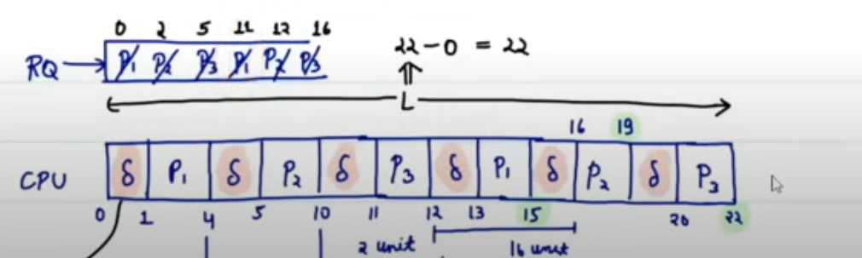
Class Exercise: FCFS with IO Burst Time
CPU Overhead = 1 unit
The Gantt Chart for the schedule is:
Process | Arrival Time | Burst Time | IO Burst | Burst Time | Wait time
P1 | 0 | 3 | 7 | 2 | ?
P2 | 2 | 5 | 2 | 3 | ?
P3 | 5 | 1 | 4 | 2 | ?

Slide 24
Class Exercise: FCFS with IO Burst
CPU overhead is 1 unit
Process | Arrival Time | IO Burst Time | Burst Time | IO Burst Time | Wait time
P1 | 0 | 5 | 2 | 3 | ?
P2 | 0 | 2 | 10 | 4 | ?
P3 | 0 | 6 | 2 | 1 | ?

Slide 25
Comments on FCFS
Advantage
  Simple and easy to program
Disadvantages
  Non-Preemptive scheduling algorithm so after the process has been allocated to the CPU, it will never release the CPU until it finishes executing or blocked.
  The Average Waiting Time is high.
  Short processes at the back wait for the long process at the front.
  Not an ideal technique for time-sharing systems.

Slide 26
Shortest Job First (SJF) Scheduling Policy
Associate with each process the length of its next CPU burst
  Use these lengths to schedule the process with the shortest time
  once CPU given to the process it cannot be preempted until completes its CPU burst
SJF is optimal – gives minimum average waiting time and turnaround time for a given set of processes
Disadvantages
  Can cause starvation if there is a steady supply of shorter processes
  Difficult to know the future (length of the next CPU request)
    Could ask the user
    Estimate CPU burst length based on past

Slide 27
SJF Scheduling Policy
The Gantt Chart for the schedule is:
Waiting time for P₁ = 3; P₂ = 16; P₃ = 9; P₄ = 0
Average waiting time: (3 + 16 + 9 + 0)/4 = 7
Process | Burst Time
P₁ | 6
P₂ | 8
P₃ | 7
P₄ | 3
P₄
P₁
P₃
P₂
0
3
9
16
24

Slide 28
Class Exercise: SJF Scheduling Policy
The Gantt Chart for the schedule is:
Waiting time for P₁ = 7; P₂ = 14; P₃ = 3; P₄ = 0
Average waiting time: (7 + 14 + 3 + 0)/4 = 6
Process | Burst Time
P₁ | 7
P₂ | 8
P₃ | 4
P₄ | 3
P₄
P₃
P₁
P₂
0
3
7
14
22

Slide 29
Class Exercise: SJF with Arrival Time
The Gantt Chart for the schedule is:
Waiting time for P₁ = 0; P₂ = 14; P₃ = 2; P₄ = 6
Average waiting time: (0 + 14 + 2 + 6)/4 = 5.5
Process | Arrival Time | Burst Time
P₁ | 0 | 6
P₂ | 2 | 8
P₃ | 4 | 7
P₄ | 7 | 3
P₁
P₃
P₄
P₂
0
6
13
16
24

Slide 30

SJF with Predicted Time
What if we predict based on process size?
Take the average of the previous processes’ burst times
Exponential Average
Example:
Process | Burst Time
P₁ | 4
P₂ | 8
P₃ | 5
P₄ | 6
$$τ_{n+1}=α t_{n}+\left(1−α\right)τ_{n}$$
$${ Find τ}_{5} when α=0.5 andτ_{1}=5?$$

Slide 31
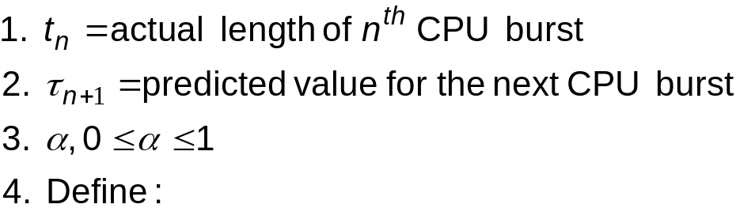



Determining Length of Next CPU Burst
Can only estimate the length – should be similar to the previous one
  Then pick process with shortest predicted next CPU burst
Can be done using length of previous CPU bursts, using exponential averaging
Commonly 𝛼 set to ½
𝛼 = 0
  (recent history does not count)
𝛼 = 1
  (only the actual last CPU burst counts)
$$τ_{n+1}=α t_{n}+\left(1−α\right)τ_{n}$$
$$τ_{n+1}=τ_{n}$$
$$τ_{n+1}={ατ}_{n}$$

Slide 32
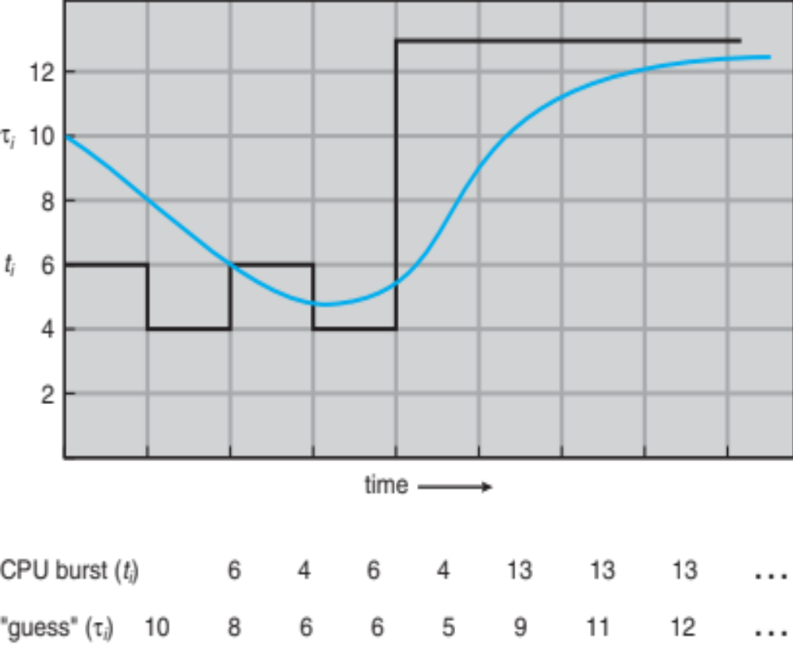
Predicting Length of the Next CPU Burst

Slide 33
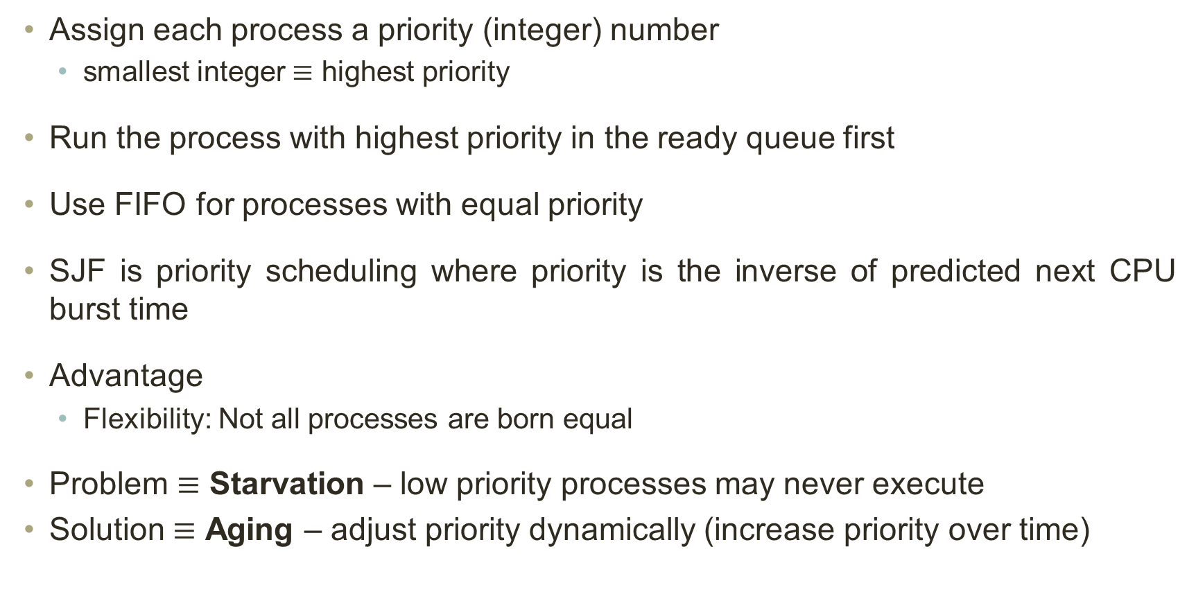
Priority Scheduling Policy
Assign each process a priority (integer) number
  smallest integer $≡$ highest priority
Run the process with highest priority in the ready queue first
Use FIFO for processes with equal priority
SJF is priority scheduling where priority is the inverse of predicted next CPU burst time
Advantage
  Flexibility: Not all processes are born equal
Problem $≡$ Starvation – low priority processes may never execute
Solution $≡$ Aging – adjust priority dynamically (increase priority over time)

Slide 34
Priority Scheduling Policy
The Gantt Chart for the schedule is:
Waiting time for P₁ = 6; P₂ = 0; P₃ = 16; P₄ = 18; P₅ = 1
Average waiting time: (6 + 0 + 16 + 18 + 1)/5 = 8.2
Process | Burst Time | Priority
P₁ | 10 | 3
P₂ | 1 | 1
P₃ | 2 | 4
P₄ | 1 | 5
P₅ | 5 | 2
P₂
P₅
P₁
P₃
P₄
0
1
6
16
18
19

Slide 35
SRTF Scheduling Policy
Shortest Remaining Time First scheduling
  Preemptive version of SJF.
  Schedule the process with the minimum remaining time
  Recalculate the remaining execution time for each process upon arrival of a process
Advantage
  Minimal average waiting and turnaround time for a given set of processes
Disadvantage
  Like SJF, can cause starvation for longer processes

Slide 36
SRTF Scheduling Policy
The Gantt Chart for the schedule is:
Waiting time for P₁ = 9; P₂ = 0; P₃ = 15; P₄ = 2
Average waiting time: (9 + 0 + 15 + 2)/4 = 6.5
Process | Arrival Time | Burst Time
P₁ | 0 | 8
P₂ | 1 | 4
P₃ | 2 | 9
P₄ | 3 | 5
P₁
P₂
P₄
P₁
P₃
0
1
5
10
17
26

Slide 37
Class Exercise: SRTF Scheduling Policy
The Gantt Chart for the schedule is:
Waiting time for P₁ = 7; P₂ = 0; P₃ = 12; P₄ = 1
Average waiting time: (7 + 0 + 12 + 1)/4 = 5
Process | Arrival Time | Burst Time
P₁ | 0 | 7
P₂ | 1 | 3
P₃ | 2 | 8
P₄ | 3 | 4
P₁
P₂
P₄
P₁
P₃
0
1
4
8
14
22

Slide 38
Preemptive Priority Scheduling
A number is assigned to each process that indicates its priority level.
If a newer process arrives having higher priority than the currently running process, then the currently running process is preempted.
Important Points
The waiting time for the process having the highest priority
  will always be zero in preemptive mode.
  may not be zero in non-preemptive mode
Preemptive and non-preemptive mode behaves exactly same, if
  The arrival time of all the processes is same
  All the processes become available

Slide 39
Priority Scheduling Policy
The Gantt Chart for the schedule is:
Waiting time for P₁ = 11; P₂ = 8; P₃ = 0; P₄ = 0; P₅ = 5
Average waiting time: (11 + 8 + 0 + 0 + 4)/5 = 4.6
Process | Arrival Time | Burst Time | Priority
P₁ | 0 | 4 | 4
P₂ | 1 | 3 | 3
P₃ | 2 | 1 | 2
P₄ | 3 | 5 | 1
P₅ | 4 | 2 | 1
P₁
P₂
P₃
P₄
P₅
P₂
P₁
0
1
2
3
8
10
12
15

Slide 40
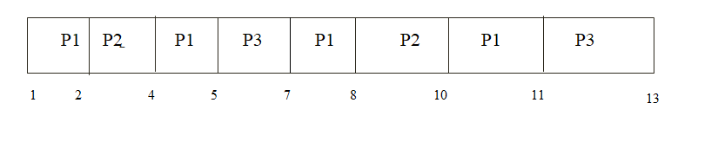
Preemptive Priority Scheduling
Consider a System with Preemptive priority-based Scheduling with 3 Processes P1, P2, and P3 with infinite instances of them. The instances of these Processes arrive at regular intervals of 3, 7 & 20 ms, respectively. The priority of the Process instances is the inverse of their periods. Each of the Process instances P1, P2, and P3 consumes 1, 2 & 4 ms of CPU time, respectively. The 1st instance of each Process is available at 1 ms. What is the Completion time of the 1st instance of Process P3?

Slide 41
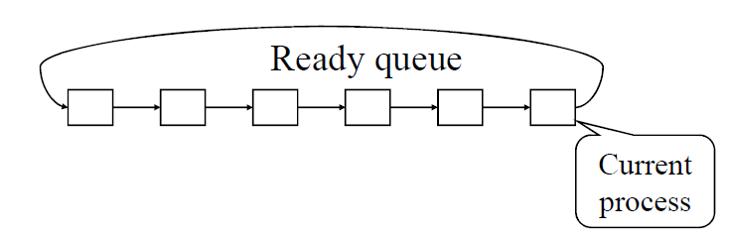
Round Robin (RR) Scheduling Policy
Each process runs a time slice or quantum q. After this time has elapsed, the process is preempted and added to the end of the ready queue.
For n processes in the ready queue and time quantum of q, each process gets 1/n of the CPU time in chunks of at most q time units. Each process waits no longer than (n-1)q time units until its next time quantum.
Timer interrupts every quantum to schedule next process
Performance
  q large → FIFO
  q small → RR

Slide 42
RR Scheduling Policy
Time slice: 4 sec
The Gantt Chart for the schedule is:
Average waiting time: (6 + 4 + 7)/3 = 5.67
Typically, higher average turnaround time than SJF, but better response time
Process | Burst Time
P₁ | 24
P₂ | 3
P₃ | 3
P₁
P₂
P₃
P₁
P₁
P₁
P₁
P₁
0
4
7
10
14
18
22
26
30

Slide 43
Class Exercise: RR Scheduling Policy
Time slice: 2 sec
The Gantt Chart for the schedule is:
Average waiting time: (8 + 8 + 2 + 4 + 7)/5 = 5.8
Process | Arrival Time | Burst Time
P₁ | 0 | 5
P₂ | 1 | 3
P₃ | 2 | 1
P₄ | 3 | 2
P₅ | 4 | 3
P₁
P₂
P₃
P₁
P₄
P₅
P₂
P₁
P₅
0
2
4
5
7
9
11
12
13
14

Slide 44
Class Exercise: RR Scheduling Policy
Time slice: 2 sec
The Gantt Chart for the schedule is:
Average waiting time: (4 + 5 + 2)/3 = 3.66
Process | Arrival Time | Burst Time | IO Burst Time | Burst Time
P₁ | 0 | 3 | 5 | 4
P₂ | 2 | 5 | 8 | 1
P₃ | 3 | 2 | 2 | 2
P₁
P₂
P₁
P₃
P₂
P₃
P₂
P₁
P₁
P₂
0
2
4
5
7
9
11
12
14
16
20
21

Slide 45
RR Scheduling Policy
Responsiveness vs Overhead
  What if the time quantum is small?
  What happens when the time quantum is large?
  If the time quantum is the maximum of the burst times, how will RR behave?

Slide 46
RR Scheduling Policy
Advantages
  Fair allocation of CPU across jobs
  Low average waiting time when job lengths vary
  best performance in terms of average response time.
  best suited for
    time sharing system,
    client server architecture and
    interactive system.
Disadvantages
  leads to starvation for processes with larger burst time
    as they have to repeat the cycle many times
  Its performance heavily depends on time quantum.

Slide 47
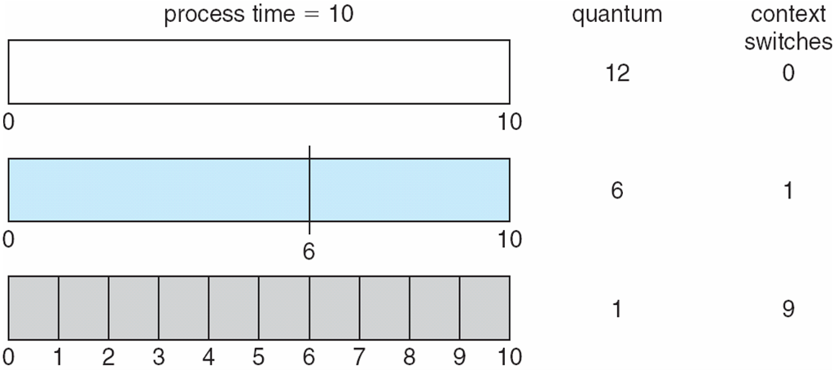
RR Scheduling Policy: Important Notes
With decreasing value of time quantum,
  Number of context switch increases
  Response time decreases
  Chances of starvation decreases
How to choose time slice?
  Overhead vs. response time
  Overhead is typically about 1% or less
  Quantum typically between 10 ~ 100 msec

Slide 48
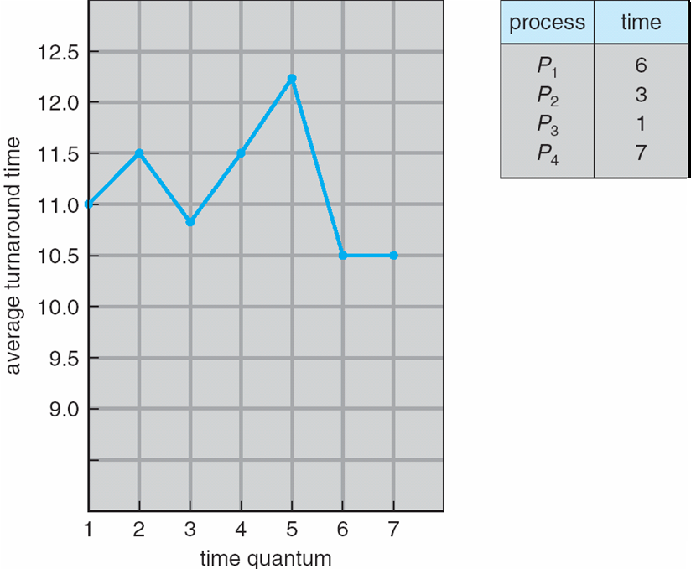
Turnaround Time Varies With Time Quantum
80% of CPU bursts should be shorter than q.

Slide 49
Priority Scheduling Policy with Round Robin
Time slice: 2 sec
The Gantt Chart for the schedule is:
Waiting time for P₁ = 22; P₂ = 11; P₃ = 12; P₄ = 0; P₅ = 24
Average waiting time: (22 + 11 + 12 + 0 + 24)/5 = 13.8
Process | Burst Time | Priority
P₁ | 4 | 3
P₂ | 5 | 2
P₃ | 8 | 2
P₄ | 7 | 1
P₅ | 3 | 3
P₄
P₂
P₃
P₂
P₃
P₂
P₃
P₁
P₅
P₁
P₅
0
7
9
11
13
15
16
20
22
24
26
27

Slide 50
Combining Algorithms
Different types of jobs have different preferences
  Interactive, CPU-bound, batch, system, etc.
Combining scheduling algorithms to optimize for multiple objectives
  Have multiple queues representing different job types
  Use a different algorithm for each queue
  Fix processes to a queue, or move processes among queues
  Need scheduling among the queues
    e.g., fixed priority preemptive scheduling (high-priority queue trumps other)
    e.g., time-slice between queues

Slide 51
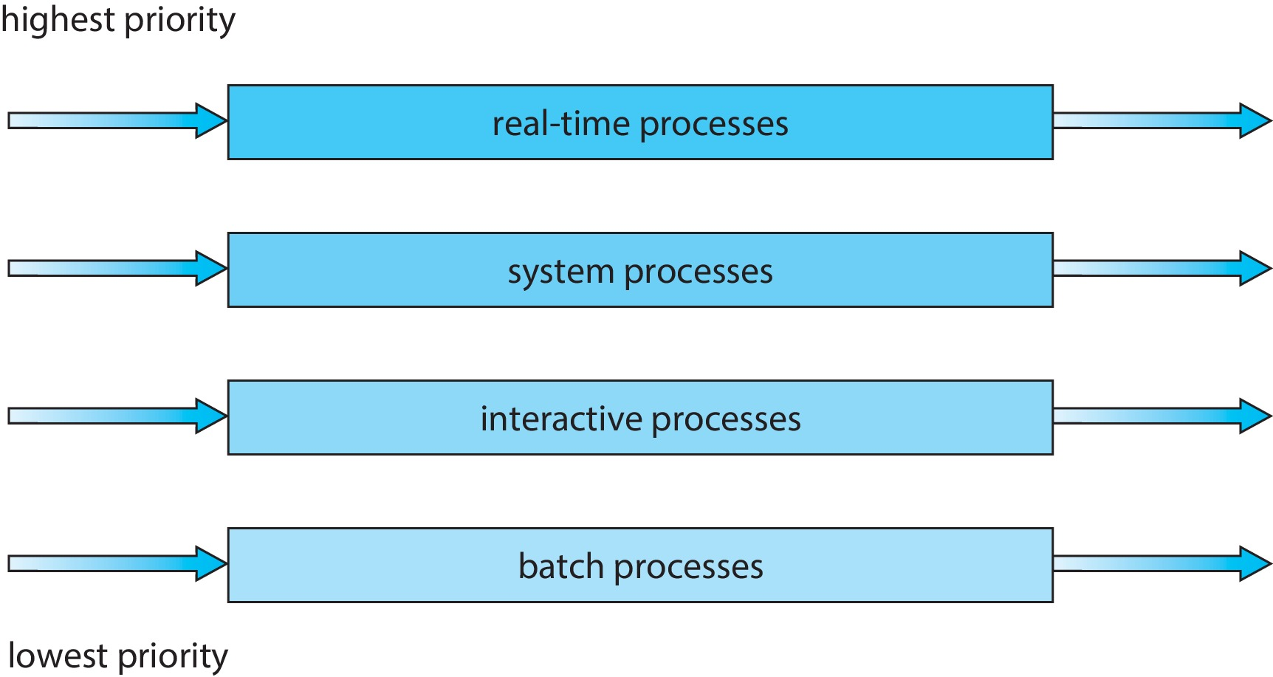
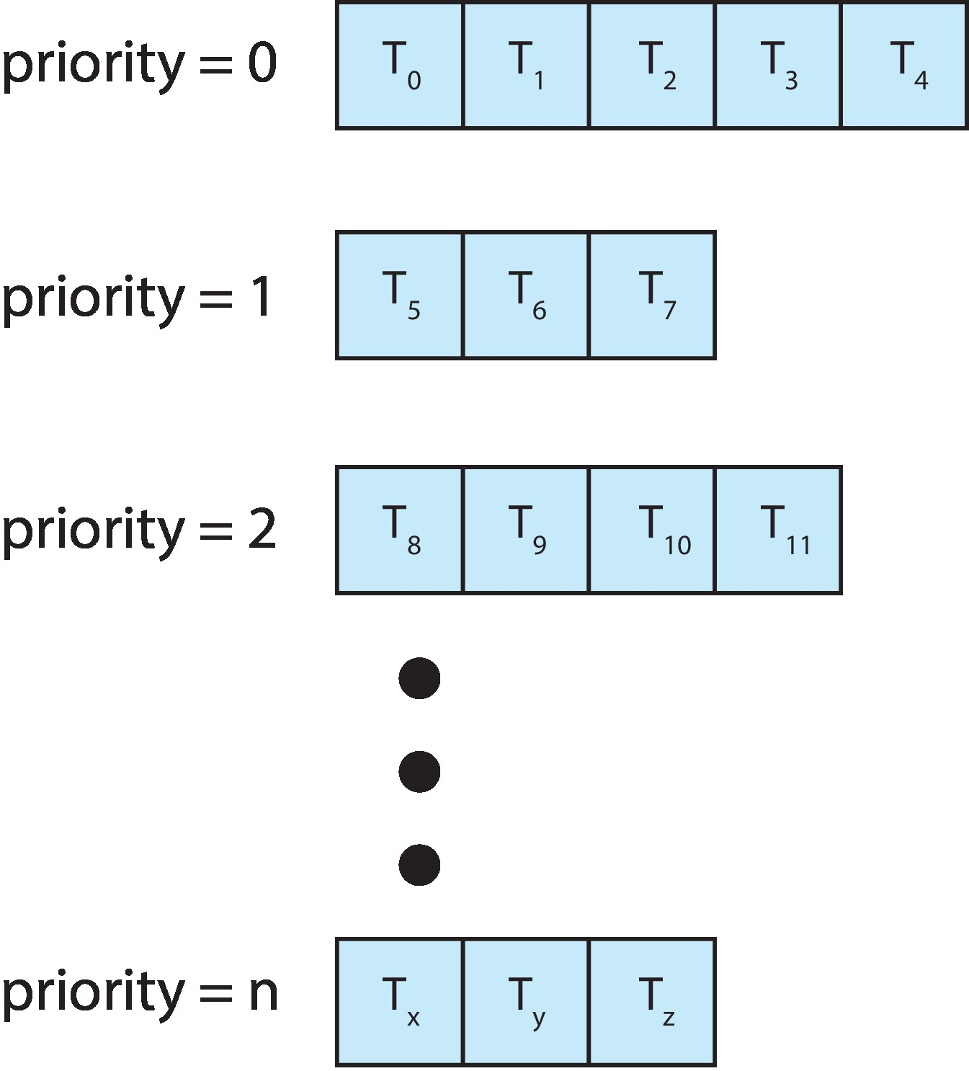
Multilevel Queue Scheduling
With priority scheduling, have separate queues for each priority.
Prioritization based upon process type
Schedule the process in the highest-priority queue!
Jobs on same queue use the same scheduling algorithm, typically RR

Slide 52
Multilevel Queue Scheduling
Pros:
  Low scheduling overhead
    Jobs do not move across queues
Cons:
  Processes permanently assigned to one queue – not flexible
  Program behavior may change
  E.g., can switch between I/O bound and CPU bound
  Need some learning/adaptation at runtime
Starvation cannot be easily handled
  Need some learning/adaptation at running

Slide 53
Multilevel Feedback Queue Scheduling
Goal # 1: Optimize job turnaround time for “batch” jobs
  Shorter jobs run first
  Why not SJF?
Goal # 2: Minimize response time for “interactive” jobs
Challenge:
  No a priori knowledge of what type of job is, what the next burst is, etc.
  Let a job tell us its “niceness” (priority)?
Idea:
  Change a process’s priority based on how it behaves in the past (history “feedback”)

Slide 54
Multilevel Feedback Queue Scheduling
Job starts at high priority queue and can move between the various queues.
Feedback
  If timeout expires, drop one level
  If waiting too long, push up one level (aging)
Leave I/O bound and interactive processes in higher-priority queue

Slide 55

Multilevel Feedback Queue Scheduling
Example: Three queues.
  Q₀ – RR with time quantum 8 milliseconds
  Q₁ – RR time quantum 16 milliseconds
  Q₂ – FCFS
Scheduling
  A new process enters queue Q₀ which is served in RR
    When it gains CPU, the process receives 8 milliseconds
    If it does not finish in 8 milliseconds, the process is moved to queue Q₁
  At Q₁ job is again served in RR and receives 16 additional milliseconds
    If it still does not complete, it is preempted and moved to queue Q₂

Slide 56
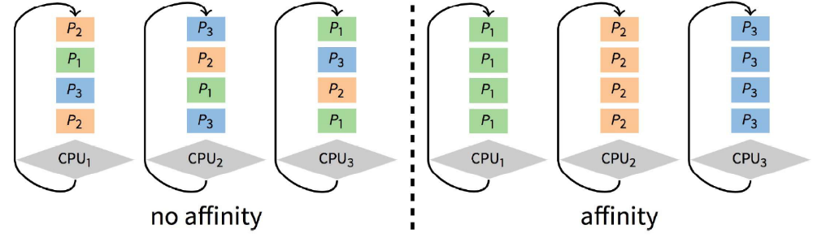
Multiprocessor Scheduling Issues
Must decide on more than which processes to run
  Must decide on which CPU to run which process
Moving between CPUs has costs
  More cache misses, depending on architecture, more TLB misses too
Affinity scheduling: Try to keep process/thread on same CPU
  But also prevent load imbalances
  Do cost-benefit analysis when deciding to migrate
  Affinity can also be harmful, particularly when tail latency is critical

Slide 57
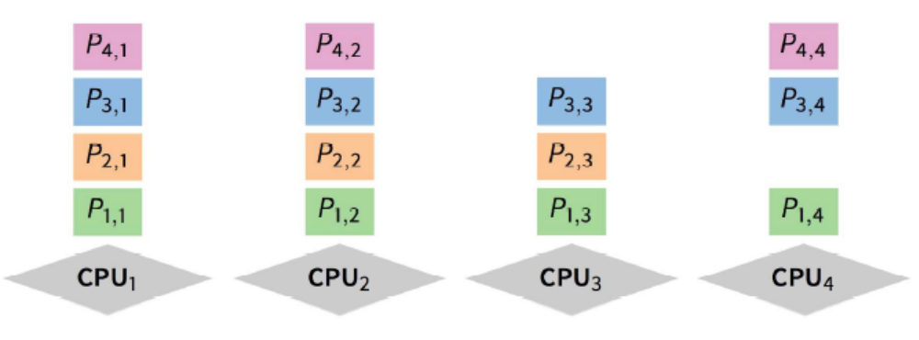
Multiprocessor Scheduling Issues
Want related processes/threads scheduled together
  Good if threads access same resources (e.g., cached files)
  Even more important if threads communicate often, other must context switch to communicate
Gang scheduling – schedule all CPUs synchronously
  Threads of same process will run together on multiprocessor
  Processes of the same application run together on cluster
  With synchronized quanta, easier to schedule related processes/threads together

Slide 58
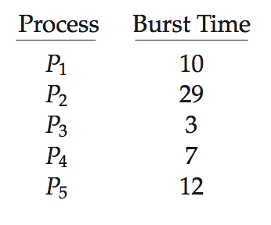
Algorithm Evaluation
How to select CPU-scheduling algorithm for an OS?
Determine criteria, then evaluate algorithms
Deterministic modeling
  Type of analytic evaluation
  Takes a particular predetermined workload and defines the performance of each algorithm for that workload
Consider 5 processes arriving at time 0:

Slide 59
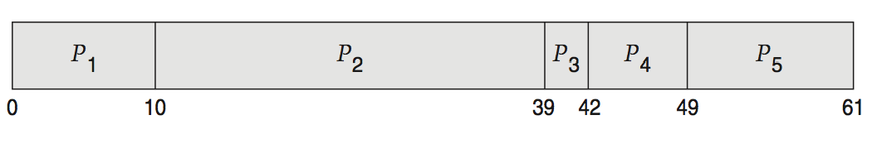
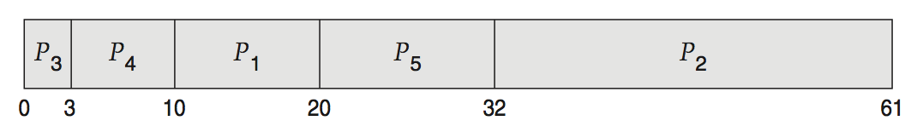
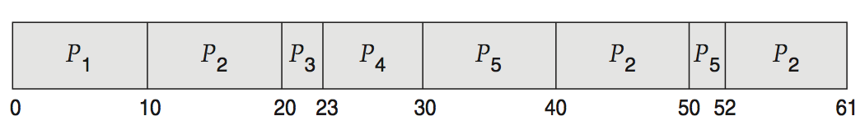
Deterministic Evaluation
For each algorithm, calculate minimum average waiting time
Simple and fast, but requires exact # for input, applies only to those inputs
  FCS is 28ms:
  Non-preemptive SFJ is 13ms:
  RR is 23ms:

Slide 60
Queueing Model
Describes the arrival of processes, and CPU and I/O bursts probabilistically
  Commonly exponential, and described by mean
  Computes average throughput, utilization, waiting time, etc.
Computer system described as network of servers, each with queue of waiting processes
  Knowing arrival rates and service rates
  Computes utilization, average queue length, average wait time, etc.

Slide 61
Little’s Formula
n = average queue length
W = average waiting time in queue
λ = average arrival rate into queue
Little’s law – in steady state, processes leaving queue must equal processes arriving, thus:
  n = λ x W
  Valid for any scheduling algorithm and arrival distribution
For example, if on average 7 processes arrive per second, and normally 14 processes in queue, then average wait time per process = 2 seconds

Slide 62
Simulations
Queueing models limited
Simulations more accurate
  Programmed model of computer system
  Clock is a variable
  Gather statistics indicating algorithm performance
  Data to drive simulation gathered via
    Random number generator according to probabilities
    Distributions defined mathematically or empirically
    Trace tapes record sequences of real events in real systems

Slide 63
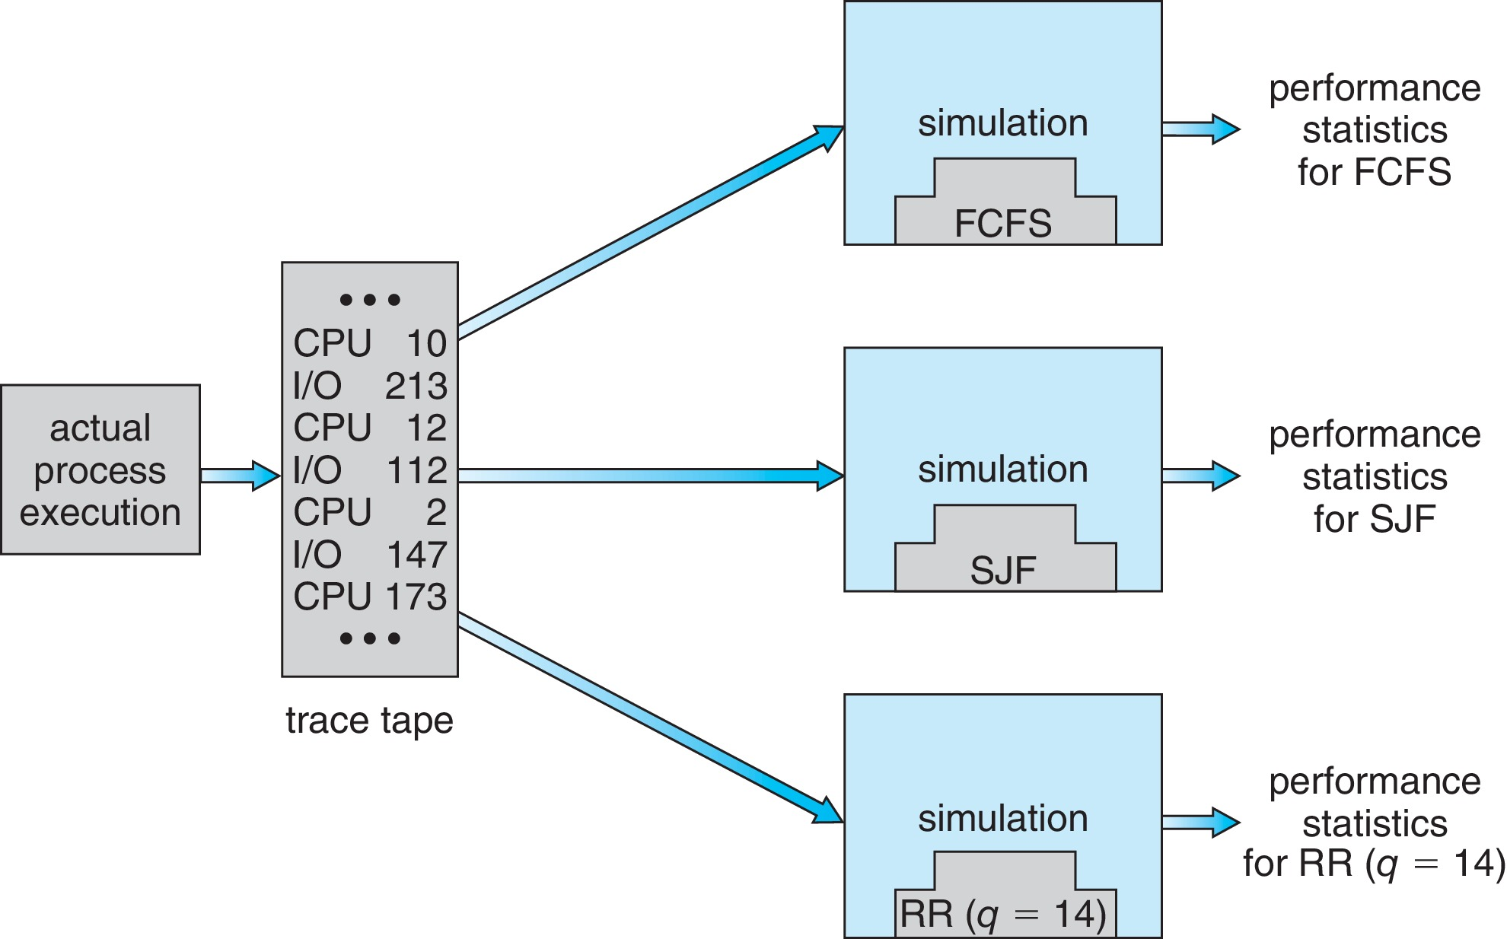
Evaluation of CPU Schedulers by Simulations

Slide 64
Implementation
Even simulations have limited accuracy
Just implement new scheduler and test in real systems
  High cost, high risk
  Environments vary
Most flexible schedulers can be modified per-site or per-system
Or APIs to modify priorities
But again, environments vary

Slide 65
Scheduling Algorithms in OSes
Operating System | Preemption | Algorithm
Windows 3.1x | None | Cooperative Scheduler
Windows 95, 98, ME | Half | Preemptive for 32-bit processes Cooperative Scheduler for 16-bit processes
Windows NT (2000, XP, Vista, 7, and Server) | Yes | Multilevel feedback queue
Mac OS pre-9 | None | Cooperative Scheduler
Mac OS 9 | Some | Preemptive for MP tasks Cooperative Scheduler for processes and threads
Mac OS X | Yes | Multilevel feedback queue
Linux pre-2.6 | Yes | Multilevel feedback queue
Linux 2.6-2.6.23 | Yes | O(1) Scheduler
Linux post-2.6.23 | Yes | Completely Fair Scheduler
Solaris | Yes | Multilevel feedback queue
NetBSD | Yes | Multilevel feedback queue
FreeBSD | Yes | Multilevel feedback queue

